Slide 1
Intermediate presentation Groep 1
Thor Galle
Midas Lambrichts
Ruben Vroonen

Slide 2
Motivation

Slide 3
Problem
What is the problem that the visualization will try to explain or solve?
Why is this problem important?
Why is this problem complex?

Slide 4
Data

Slide 5
Dataset
Antwerp Open Data:
Fietsgebruik mei 2015
Zone 30
…

Slide 6
Insights

Slide 7
Insights
What data-driven insight(s) do you expect your visualization to reveal?
Show them with rough data representations (e.g. Excel, Tableau).

Slide 8
Design rationale

Slide 9
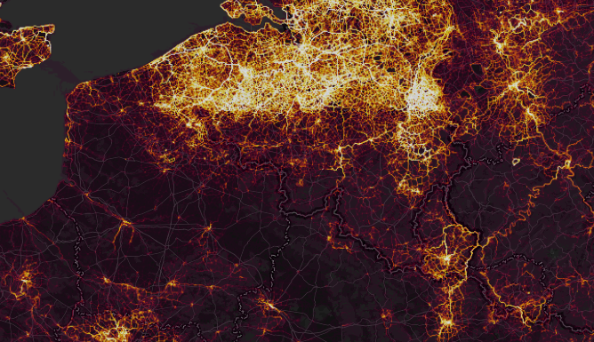
Design inspiration
What are other works that are inspirational to your design?
How might they inspire your design?
Strava Global Heatmap
https://www.strava.com/heatmap
Heatmap from routes, not points

Slide 10
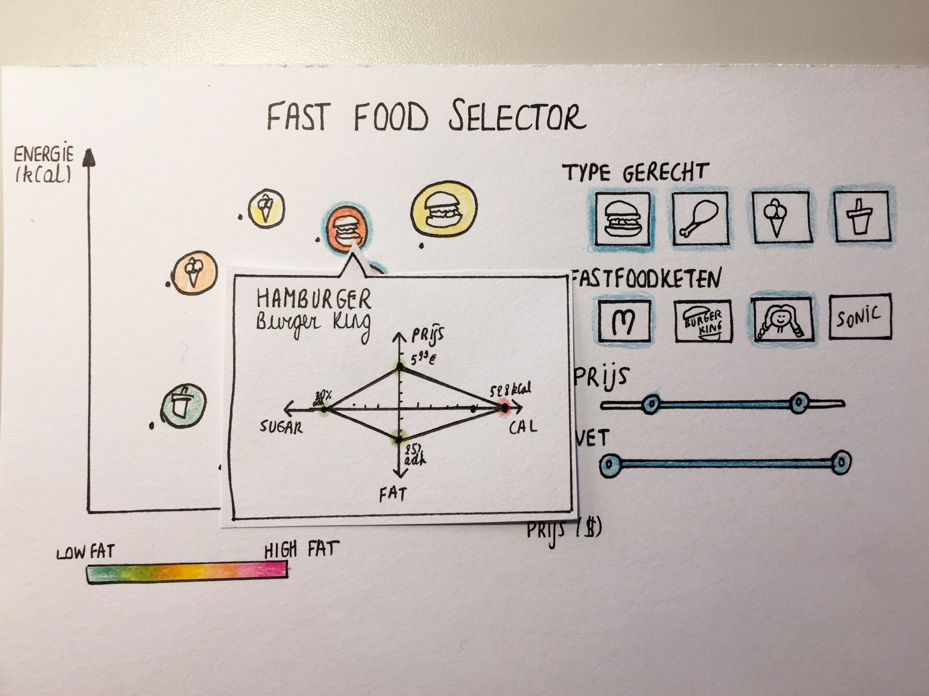
Design rationale
How will the insights be revealed via the visualization?
What design decisions did you make? Based on what reasoning?

Slide 11
Communication

Slide 12
Communication
Take the user through a “tutorial” which will show some interesting points and the effect of the controls before releasing control.

Slide 13
Interaction
Standard map controls (zoom & pan)
Determine heatmap parameters so they can gain more insight themselves

Slide 14
Demo

Slide 15
Demo
http://iv.kul/acopy.html

Slide 16
Planning

Slide 17
Planning
Finish Controls
Add more data representations (Graphs, Parallel Coordinates,…)

Slide 18
?

